Slide 1
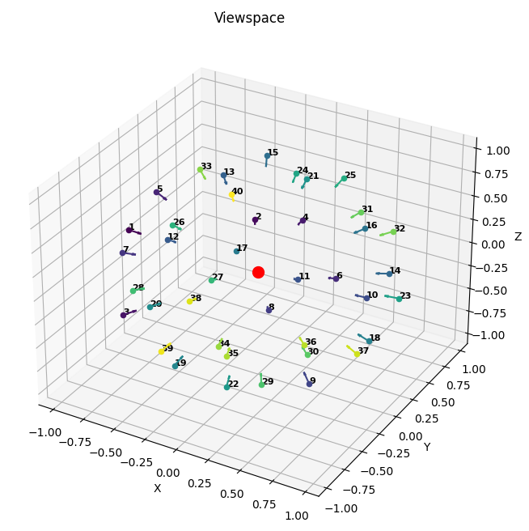
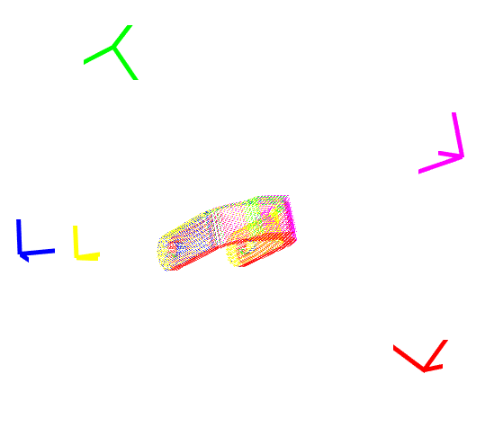
3D Scanning and Modelling of Unknown Objects with a Two-Arm Robotic System
Jiaming Yu
Advisors: M.Sc. Yucheng Tang

Slide 2
Outline
Overview
Motivation
Problem Statement
State of the art
Candidate View Space
Training Data Generation
Global View Planning Net
Conclusions and Discussion

Slide 3
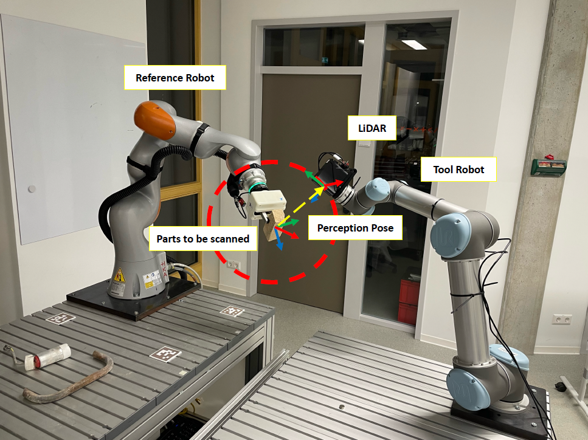
Motivation
Overview
The ROBDEKON project
Aimed at advancing robotic technology for decontamination tasks in hazardous areas
Developing autonomous and semi-autonomous robotic systems
3D reconstruction
Optimizing observation strategies
Dual-arm robots

Slide 4
Problem Statement
Overview
Predict the best views of observation
One-Shot view
Optimal Viewpoint Prediction
Predefined set of candidate viewpoints
Machine Learning for Viewpoint Sets
Training Data Collection

Slide 5
State of the art
Overview
Observation policies
Passive Observation
Active Observation
Interactive Observation
Viewpoint prediction
Next Best View
Set Covering in Model-Based View Planning

Slide 6
Outline
Overview
Candidate View Space
Spherical Codes
Define the Candidate View Space
Training Data Generation
Global View Planning Net
Conclusions and Discussion

Slide 7
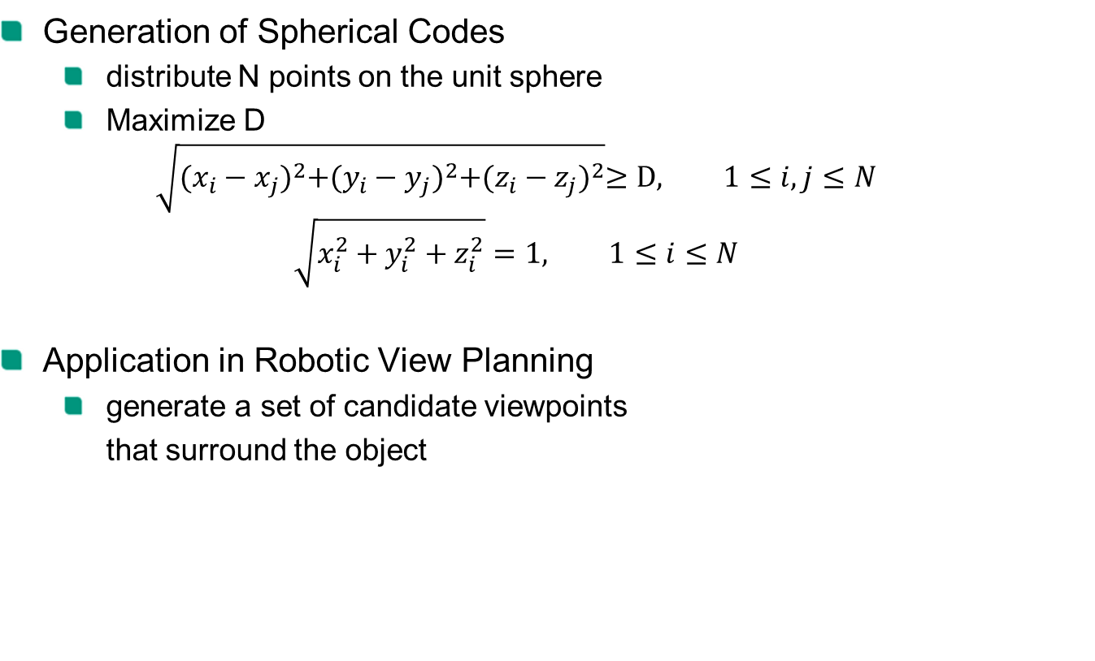
Spherical Codes
Candidate View Space
Generation of Spherical Codes
distribute N points on the unit sphere
Maximize D
$$\sqrt{{(x_{i}−x_{j})}^{2}+{(y_{i}−y_{j})}^{2}+{(z_{i}−z_{j})}^{2}}≥D, 1≤i,j≤N$$
$$\sqrt{x_{i}^{2}+y_{i}^{2}+z_{i}^{2}}=1, 1≤i≤N$$
Application in Robotic View Planning
generate a set of candidate viewpoints
that surround the object
Notes:
Omnidirectional drive test
Compare sensor data from both sides, use a PD controller to minimize the oscillation

Slide 8
Define the Candidate View Space
Candidate View Space
Number of candidate viewpoints
Coverage of the object
40 viewpoints reaches about 0.92
Increase of the coverage
the derivative drops to 0.0256% at 40 viewpoints
Notes:
Omnidirectional drive test
Compare sensor data from both sides, use a PD controller to minimize the oscillation

Slide 9
Define the Candidate View Space
Candidate View Space
Our Candidate View Space
40 candidate viewpoints
Beyond this point, no additional viewpoint contributed more than 13 observed voxels
Notes:
Omnidirectional drive test
Compare sensor data from both sides, use a PD controller to minimize the oscillation

Slide 10
Outline
Overview
Candidate View Space
Training Data Generation
Detailed Process Explanation
Training and Testing Datasets
Global View Planning Net
Conclusions and Discussion

Slide 11
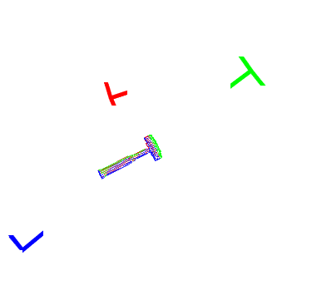
Detailed Process Explanation
Training Data Generation
Prepare 3D Model of objects
Mesh Sampling
Simulated Perception
Labeling
Data enhancement
Notes:
Omnidirectional drive test
Compare sensor data from both sides, use a PD controller to minimize the oscillation

Slide 12
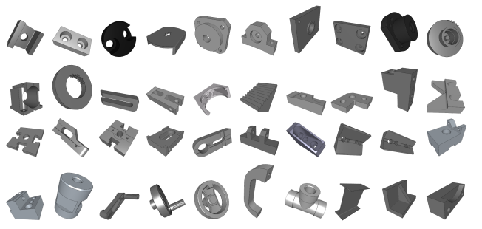
Training and Testing Datasets
Training Data Generation
Training Datasets
Notes:
Omnidirectional drive test
Compare sensor data from both sides, use a PD controller to minimize the oscillation

Slide 13
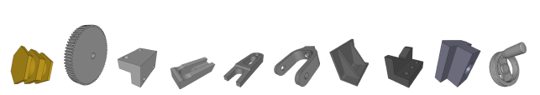
Training and Testing Datasets
Training Data Generation
Testing Datasets
Data Preprocessing
Data Organization
Data Conversion
Batch Processing and Storage
Notes:
Omnidirectional drive test
Compare sensor data from both sides, use a PD controller to minimize the oscillation

Slide 14
Outline
Overview
Candidate View Space
Training Data Generation
Global View Planning Net
Overall Network Structure
Main Components
ResNeXt-Based Global View Planning Net
Conclusions and Discussion

Slide 15
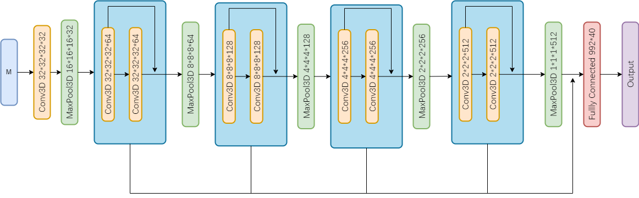
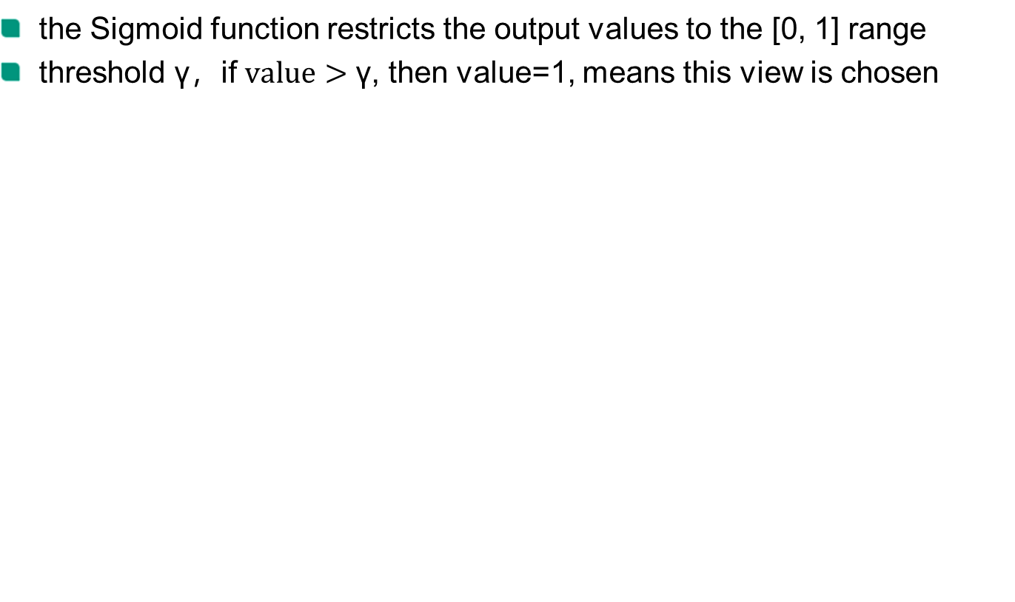
Overall Network Structure
Global View Planning Net
the Sigmoid function restricts the output values to the [0, 1] range
threshold γ，if $value>\text{γ}$, then value=1, means this view is chosen

Slide 16
Main Components
Global View Planning Net
Convolutional Layers with Residual Connections
Convolutional Layers
Residual Connections
Pooling Layers
Max Pooling
Fully Connected Layers
Activation and Loss Functions
Viewpoint Selection Strategy
Notes:
Omnidirectional drive test
Compare sensor data from both sides, use a PD controller to minimize the oscillation

Slide 17
ResNeXt-Based Global View Planning Net
Global View Planning Net
Grouped Convolutions
Notes:
Omnidirectional drive test
Compare sensor data from both sides, use a PD controller to minimize the oscillation

Slide 18
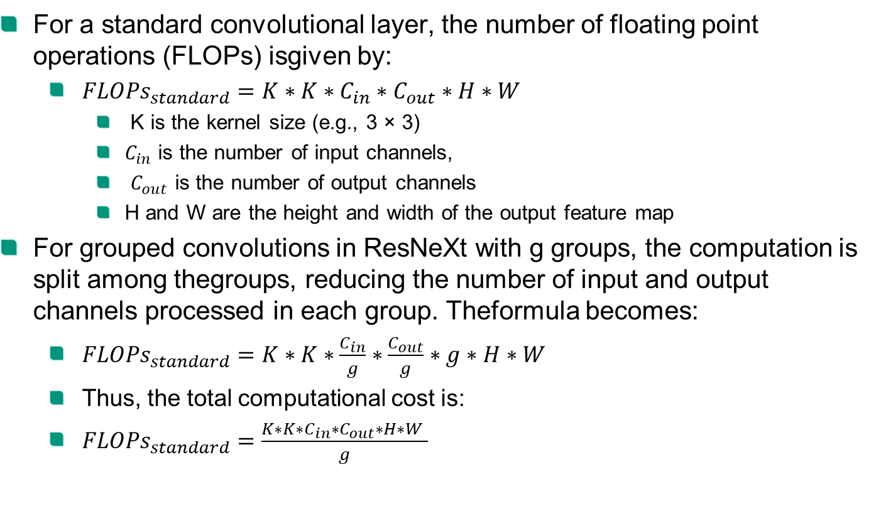
ResNeXt-Based Global View Planning Net
Global View Planning Net
For a standard convolutional layer, the number of floating point operations (FLOPs) isgiven by:
${FLOPs}_{standard}=K∗K∗C_{in}∗C_{out}∗H∗W$
K is the kernel size (e.g., 3 × 3)
$C_{in}$ is the number of input channels,
$C_{out}$ is the number of output channels
H and W are the height and width of the output feature map
For grouped convolutions in ResNeXt with g groups, the computation is split among thegroups, reducing the number of input and output channels processed in each group. Theformula becomes:
${FLOPs}_{standard}=K∗K∗\frac{C_{in}}{g}∗\frac{C_{out}}{g}∗g∗H∗W$
Thus, the total computational cost is:
${FLOPs}_{standard}=\frac{K∗K∗C_{in}∗C_{out}∗H∗W }{g}$
Notes:
Omnidirectional drive test
Compare sensor data from both sides, use a PD controller to minimize the oscillation

Slide 19
Outline
Overview
Candidate View Space
Training Data Generation
Global View Planning Net
Conclusions and Discussion
Training Results
Reconstruction Results
Real-world experiment
Future Work

Slide 20
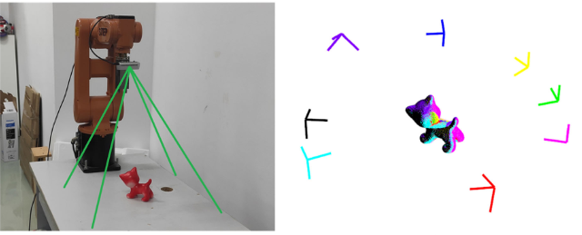
Training Results
Conclusions and Discussion
Addressing the SCVP Task with GVPN
Set Covering View Planning (SCVP)-Net
Hemispherical Viewpoints Prediction
Active Observation
Use our network to solve this Hemispherical Viewpoints Prediction problem
Notes:
Omnidirectional drive test
Compare sensor data from both sides, use a PD controller to minimize the oscillation

Slide 21
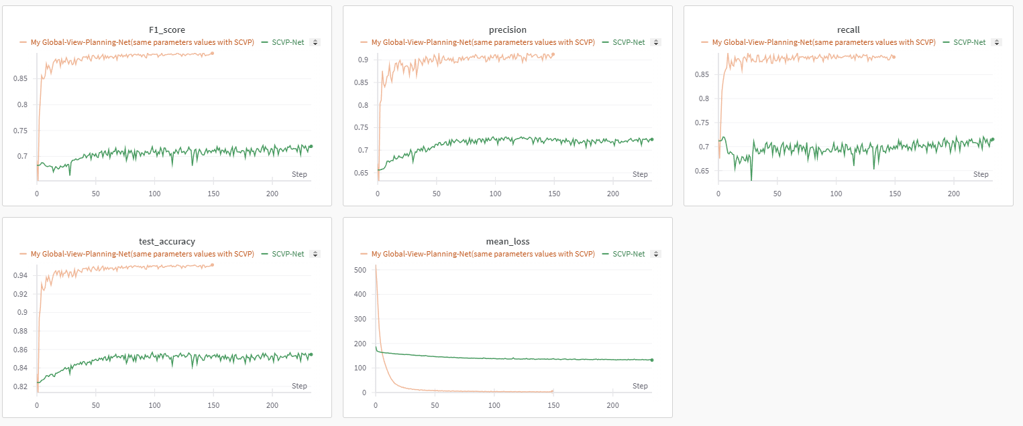
Training Results
Conclusions and Discussion
Notes:
Omnidirectional drive test
Compare sensor data from both sides, use a PD controller to minimize the oscillation

Slide 22
Training Results
Conclusions and Discussion
Comparison of SCVP Network and Our Network(GVPN) Performance
Metric | SCVP Network | GVPN
Precision | 0.7297 | 0.91551
Recall | 0.72034 | 0.89518
F1-Score | 0.72223 | 0.89989
Accuracy | 0.85693 | 0.95176
Notes:
Omnidirectional drive test
Compare sensor data from both sides, use a PD controller to minimize the oscillation

Slide 23
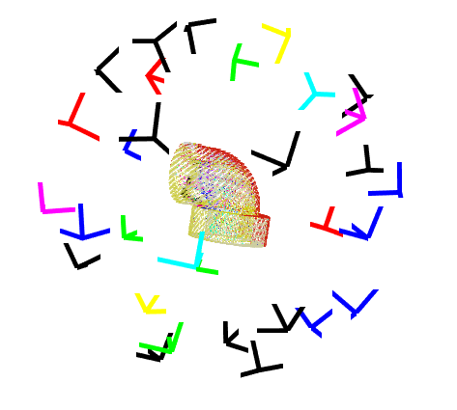
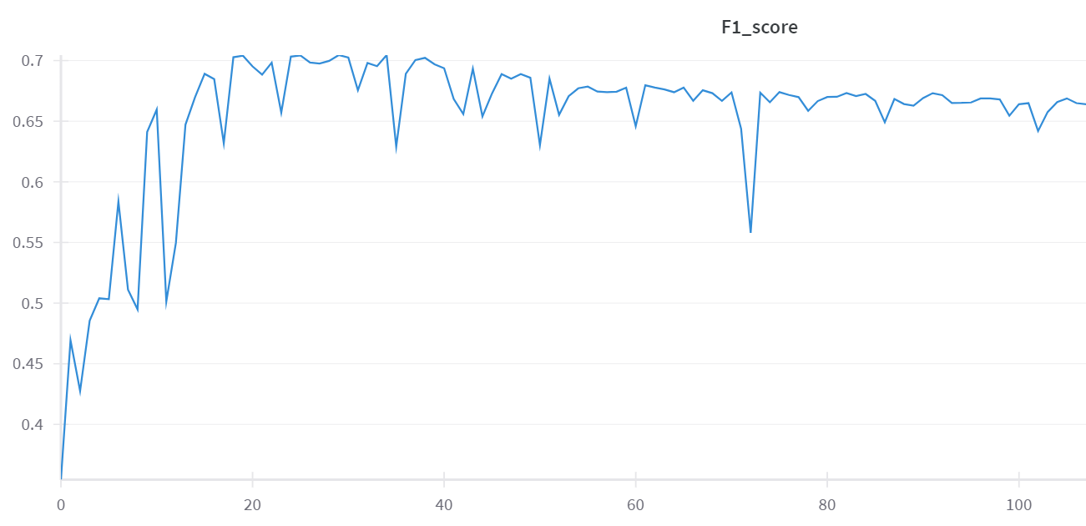
Training Results
Conclusions and Discussion
Global View Prediction Across the entire Sphere
GVPN
BCEWithLogitsLoss with CustomWeights
the Adam optimizer
threshold γ = 0.3
Notes:
Omnidirectional drive test
Compare sensor data from both sides, use a PD controller to minimize the oscillation

Slide 24
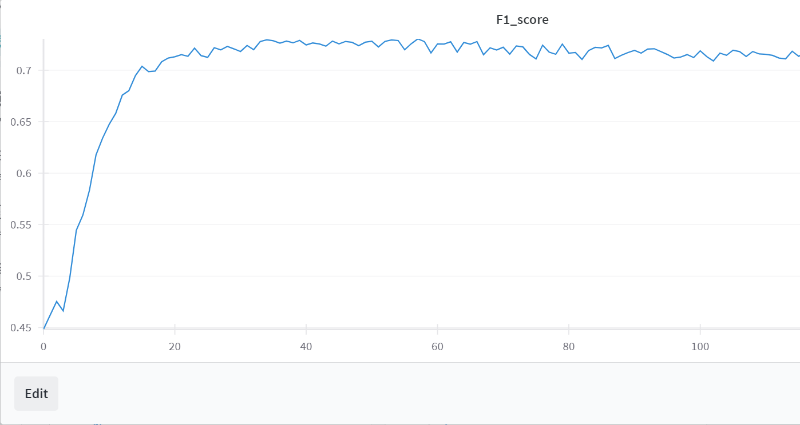
Training Results
Conclusions and Discussion
Global View Prediction Across the Sphere
ResNeXt-Based GVPN
BCEWithLogitsLoss with CustomWeights,
the Adam optimizer
threshold γ = 0.3
Notes:
Omnidirectional drive test
Compare sensor data from both sides, use a PD controller to minimize the oscillation

Slide 25
Training Results
Conclusions and Discussion
Comparison of GVPN and ResNeXt-Based GVPN
Metric | GVPN | ResNeXt-Based GVPN
Precision | 0.61478 | 0.64068
Recall | 0.82488 | 0.84788
F1-Score | 0.7045 | 0.72986
Accuracy | 0.78136 | 0.78424
Notes:
Omnidirectional drive test
Compare sensor data from both sides, use a PD controller to minimize the oscillation

Slide 26
Reconstruction Results
Conclusions and Discussion
Comparison of Reconstruction Coverage
Method | Coverage (%)
SCVP(Hemispherical) | 79.85
GVPN | 88.11
ResNeXt-based GVPN | 89.59
Notes:
Omnidirectional drive test
Compare sensor data from both sides, use a PD controller to minimize the oscillation

Slide 27
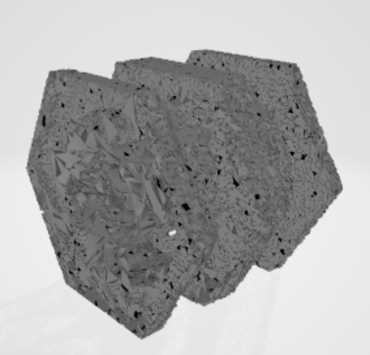
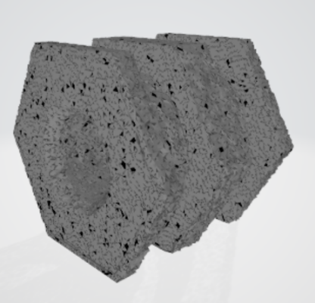
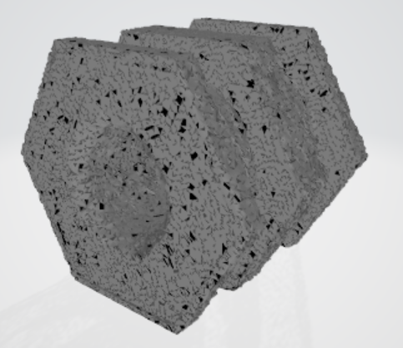
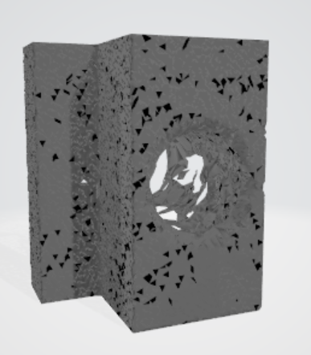
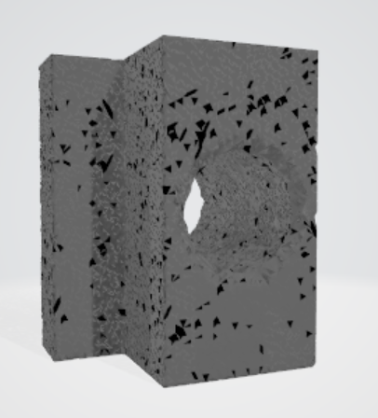
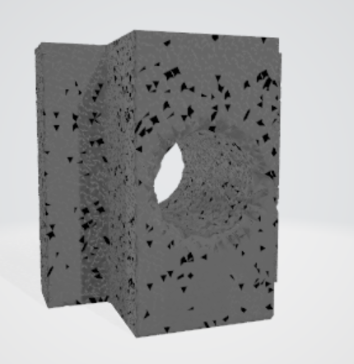
Reconstruction Results
Conclusions and Discussion
Comparison of Reconstruction Results
SCVP
GVPN
ResNeXt-based GVPN
Notes:
Omnidirectional drive test
Compare sensor data from both sides, use a PD controller to minimize the oscillation

Slide 28
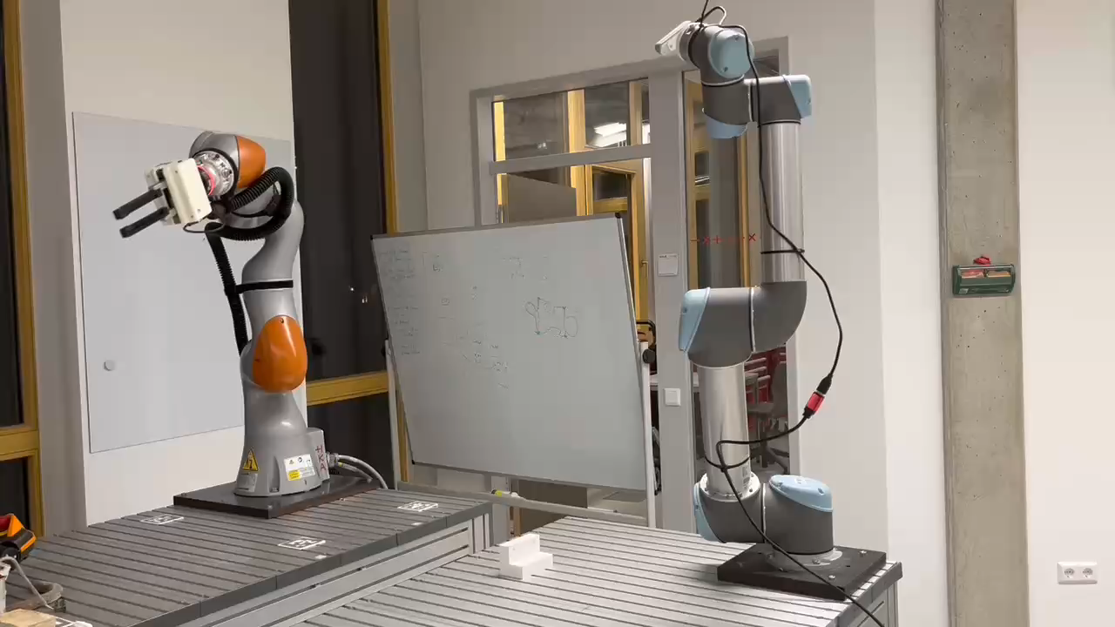
Real-world experiment
Conclusions and Discussion
Notes:
Omnidirectional drive test
Compare sensor data from both sides, use a PD controller to minimize the oscillation

Slide 29
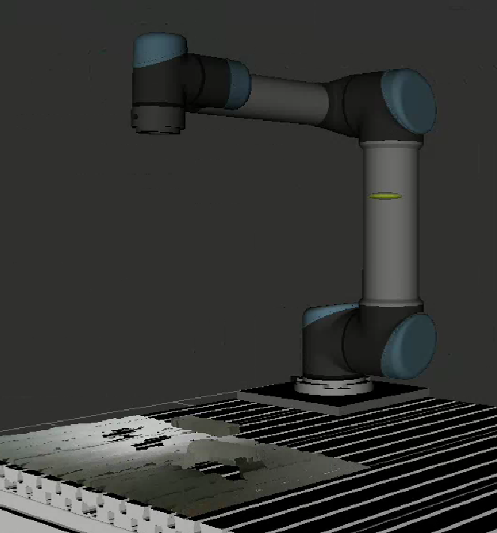
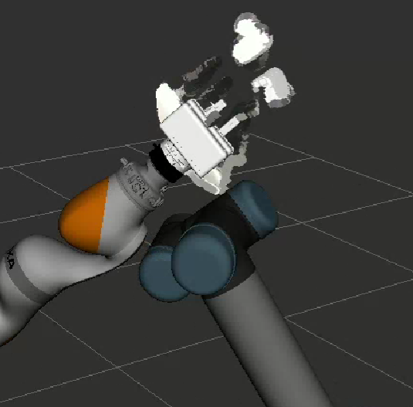
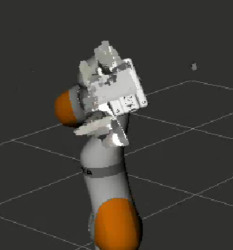
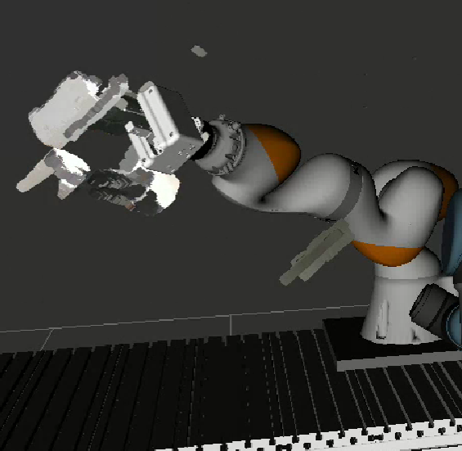
Real-world experiment
Conclusions and Discussion
The points cloud we get from each viewpoint
Input of network: point cloud from the initial viewpoint
Output of network: the subsequent viewpoints to be observed
Problem
Calibration
The rotational error tolerance of the IK (Inverse Kinematics) solution
Points cloud from initial view
Points cloud from the 1st predicted view
Points cloud from the 2nd predicted view
Points cloud from the 3rd predicted view
Notes:
Omnidirectional drive test
Compare sensor data from both sides, use a PD controller to minimize the oscillation

Slide 30
Future Work
Conclusions and Discussion
Improving network architecture
Depth of the neural network
Number of feature extraction channels
Using point cloud data for training
Higher resolution than voxel-based training
Generating training data from real-world cameras
Reconstruction
More Refined 3D Reconstruction Method(For example, Poisson reconstruction)
Calibration
Path planning
Notes:
Omnidirectional drive test
Compare sensor data from both sides, use a PD controller to minimize the oscillation

Slide 31
Acknowledgments
Thanks for your attention!
Notes:
Omnidirectional drive test
Compare sensor data from both sides, use a PD controller to minimize the oscillation

